Slide 1



Machine Learning Techniques For Diabetes Detection Using
Iris And Conjunctival Images
PRESENTED BY:
MR. EHTESHAM SANA
Department of Computer Engineering, Z.H.C.E.T, A.M.U.
SUPERVISOR: |  | CO-SUPERVISOR:
DR. NADEEM AKHTAR |  | DR. HAMID ASHRAF
Department of Computer Engineering, Z.H.C.E.T, A.M.U. |  | Rajiv Gandhi Centre for Diabetes and Endocrinology, J.N.M.C.H

Slide 2


OVERVIEW
Introduction
Literature Review
Problem Statement
Proposed Solution
Experiments
5.1 Experiment 1 – Utilizing Iris Features
5.2 Experiment 2 – Utilizing Conjunctival Features
5.3 Experiment 3 – Utilizing Iris-conjunctival Features
Conclusion & Future Work
References

Slide 3

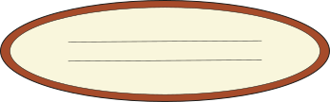

1. Introduction

Slide 4

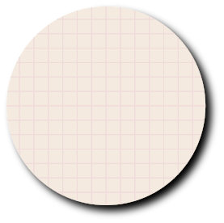

1. INTRODUCTION
537 million adults are living with diabetes.[1]
240 million people living
with undiagnosed diabetes

Slide 5
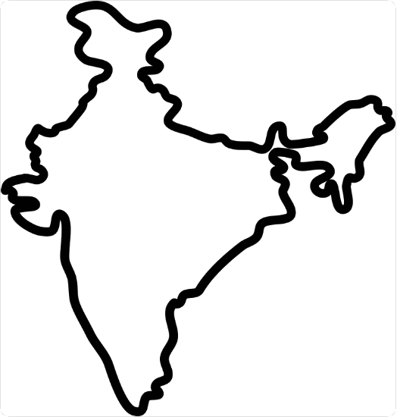
1. INTRODUCTION
India is the 'diabetes capital of the world', According to a study by the Indian Council of Medical Research. [2]
101 million people are living with diabetes.
101 million diabetic
patient
50% unaware of their diabetic status

Slide 6
1. INTRODUCTION
Methods For Diabetes Detection:
Traditional Methods (Commercially Available)
Non-Traditional Methods (Under Research)

Slide 7
1. INTRODUCTION
1. Traditional Methods For Diabetes Detection
Traditional Method | Details
1.Hemoglobin A1c Test (HbA1c): | Reflects average blood sugar level for the past two to three months. Diabetes: A1c level of 48 mmol/mol (6.5%) or higher on two separate tests. [3]
2. Fasting Plasma Glucose Test (FPG): | Measures blood sugar after an overnight fast. Diabetes: 126 mg/dL or higher on two separate tests. [4]
3.Oral Glucose Tolerance Test: | Measures blood glucose before and 2 hours after consuming a glucose-containing beverage. Diabetes: 200 mg/dL or higher after two hours. [5]
4. Random Plasma Glucose Test: | Measures blood sugar without regard to last meal timing. Diabetes: 200 mg/dL or higher. [6]

Slide 8
1. INTRODUCTION
1. Traditional Methods For Diabetes Detection
Traditional Method | Details
5. Glycosuria Test: | Detects the presence of glucose in the urine. Positive results typically require confirmation with more specific blood glucose tests. [7]
6. Semi-Invasive Glucose Monitoring Patches | Easy Tracking: These patches use small sensors under the skin to measure sugar levels, offering immediate results. Better Health Choices: They allow constant monitoring of sugar levels, aiding in better decision-making for meals, physical activities, and medicine use.

Slide 9
1. INTRODUCTION
2. Non-Traditional Methods For Diabetes Detection [8]
Method | Definition | Requirement
1. Breath Analysis: | Detecting higher acetone levels in diabetic patients' breath. | Under research
2. Saliva Testing: | Researching the correlation between saliva and blood glucose levels. | Under research
3. Tear Analysis: | Developing devices to monitor tear glucose levels. | Under research
4. Sweat Monitoring: | Track glucose levels continuously via sweat analysis using biosensors. | Under research
5. Spectroscopy: | Using light waves to measure glucose levels. | Under research
6. Iris & Conjunctival Analysis: | It involves the examination and processing of high-resolution images of the iris and conjunctiva to identify early microvascular changes indicative of diabetes. | Can use existing Hardware

Slide 10
1. INTRODUCTION
Why Iris & Conjunctival Analysis a top non-invasive method?
Universality: Eye provides a consistent sample unaffected by environment.
Use of Existing Infrastructure: Does not require specialized hardware.
Broad Accessibility : High-quality cameras, including those on smartphones, can be used for image capturing.
Automated Analysis: Machine learning can provides a fast, objective, and automated analysis of iris and conjunctival images.
Patient Comfort: Quick, painless, non-intrusive image capturing.
Telemedicine Compatibility: Ideal for remote screening, especially in underserved areas.

Slide 11
2. LITERATURE REVIEW

Slide 12
2. LITERATURE REVIEW
Iris Method:
Study | Year | Method Used | Dataset Description | Accuracy
Önal et al. [9] | 2023 | Deep learning | 30 diabetic patients and 38 healthy | 80%
Aminah et al. [10] | 2019 | Machine Learning | 16 non-diabetic and 11 diabetic subjects | 84.6%
Parsa et al. [11] | 2018 | Machine Learning | 138 diabetic patients and 138 healthy | 91.8%
Lesmana et al. [12] | 2011 | Deep learning | 30 DM images and 20 healthy images | 83.3%

Slide 13
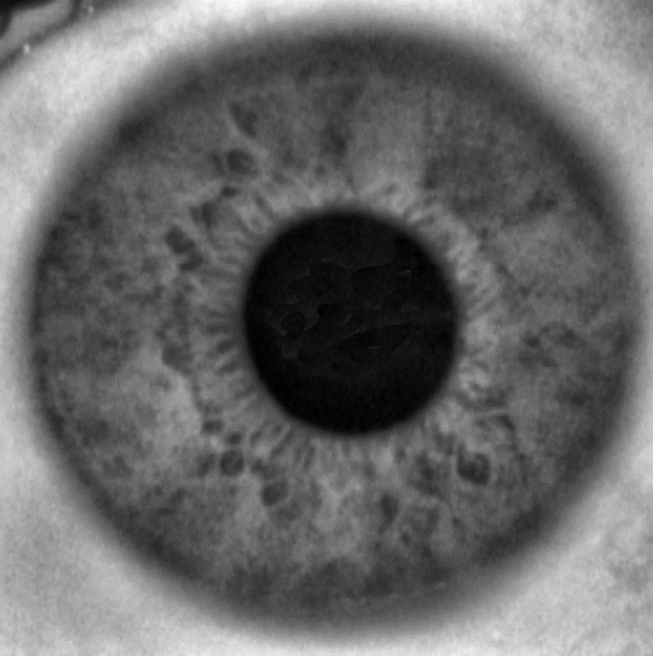
2. LITERATURE REVIEW
Diving deeper into Iris Method:
Iridology: The study of iris patterns and colors for systemic health detection, including diabetes.
Rubeosis Indication: Iris imaging can reveal rubeosis, or neovascularization, an early sign of diabetes.
Machine Learning: Algorithms effectively spot minute iris changes, improving detection accuracy.
Early, Non-invasive Diagnosis: Through iris changes, iridology allows potential early diabetes detection in a painless, accessible way.
Fig 1: Iris Image

Slide 14
2. LITERATURE REVIEW
Conjunctival Method:
Study | Year | Key Findings
Zhang et al. [13] | 2022 | Employed deep learning method for diabetes detection using conjunctival images. The study achieved 75% accuracy with a dataset comprising 405 images from 68 diabetic patients and 206 from 62 healthy individuals.
Maziyar et al. [14] | 2016 | Demonstrated a correlation between various stages of diabetic retinopathy and conjunctival microvasculature images, providing insights into potential early detection methods.
Wilson et al. [15] | 2011 | Successfully established a correlation between conjunctival microangiopathy and retinopathy in Type-2 Diabetes Mellitus patients, highlighting the potential for early pathological detection in the retina via the bulbar conjunctiva.

Slide 15
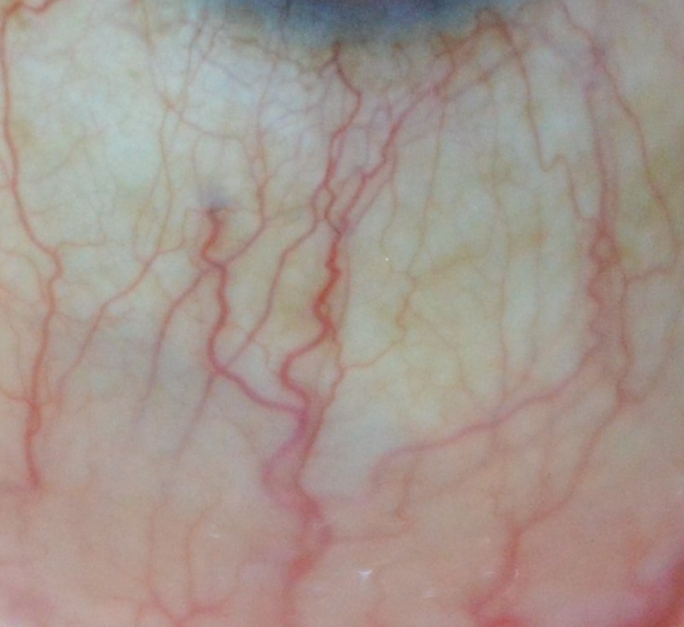
2. LITERATURE REVIEW
Diving deeper into Conjunctival Method:
Vascular Changes: Conjunctival images capture diabetes-induced alterations in eye blood vessels.
Diabetes Indicators: Visible abnormalities in conjunctiva, such as microaneurysms and hemorrhages, suggest diabetes.
Machine Learning: Algorithms effectively identify subtle diabetes signs in conjunctival images.
Early Detection: Conjunctival imaging, aided by machine learning, identifies early, subtle vascular changes caused by elevated glucose levels, enabling potential early diabetes diagnosis.
Fig 2: Conjunctival Image

Slide 16
3. PROBLEM STATEMNT

Slide 17
3. PROBLEM STATEMENT
1. Current gap: Despite medical advances, 50% of diabetes remains undetected.
2. Existing methods: Current tests are invasive or lacking in accuracy and early detection.
3. Under Utilization of Existing Infrastructure: Current non-invasive methods demand hardware which are under research.
4. ML vs. DL: Deep learning shows promise but needs extensive resources and lacks interpretability. Machine learning techniques provide computationally cheaper and interpretable alternative.
5. Dataset limitation: The lack of publicly available and geographically diverse (particularly for the Indian demographic) iris and conjunctival image datasets with diabetic and non-diabetic labels hampers the development of effective machine learning models.
6. Fusion of Eye Features: Machine learning's potential to merge iris and conjunctival image features for diabetes detection remains largely unexplored.

Slide 18
4. PROPOSED SOLUTION

Slide 19
4. PROPOSED SOLUTION
Non-Invasive Techniques: Utilizing iris and conjunctival images for diabetes detection, offering a pain-free, risk-free approach.
Machine Learning: Employing advanced algorithms to analyze the above images, enhancing accuracy in early diabetes detection.
Iris Images Experiment: Dedicated analysis using machine learning on iris images, validating their significance in diabetes detection.
Conjunctival Images Study: Exploration of under-utilized conjunctival images, connecting their distinct features with diabetes indicators.
Feature Fusion: Combining the power of iris and conjunctival features for comprehensive, more accurate detection outcomes.

Slide 20
4. PROPOSED SOLUTION
Image Preprocessing
Model Training Pipeline
Apply Otsu's Thresholding
Reshape Images
Identify the Desired Contour
Encode Labels
Comparison of Results of Different Classifiers
Load the Dataset
Create & Apply the Mask
Split data for Training & Test
Cropping the relevant region
Train, Predict, and Evaluate
Fig 3: Different Stages of Proposed Methodology

Slide 21
4. PROPOSED SOLUTION
Bridging Data Gaps:
A. Iris Dataset
Issue with Existing Data: The only publicly existing dataset with iris images contained 236 images, inadequately labeled for diabetic and non-diabetic categories.
Need for Comprehensive Data: Due to the data scarcity, it was essential to gather a more extensive dataset for a thorough analysis.
Collection of New Data: Collected 800 new iris images, meticulously labeled as diabetic and non-diabetic.
Formation of Larger Dataset: This new collection led to the formation of a larger, more comprehensive dataset for enhanced investigation.

Slide 22
4. PROPOSED SOLUTION
Bridging Data Gaps:
B. Conjunctival Dataset
Absence of Public Data: No publicly accessible dataset was available for conjunctival images for diabetes research.
Need for Specialized Data: The absence called for the creation of a specific dataset for better exploration and understanding.
Creation of New Data: Gathered a new set of 572 conjunctival images, diligently categorized as diabetic and non-diabetic.
Enriched Data Resource: This initiative resulted in a valuable, tailor-made dataset for advanced study in the field of diabetes detection.

Slide 23
4. PROPOSED SOLUTION
Bridging Data Gaps:
MATERIAL AND METHODS
This hospital-based study was conducted on patients both with Diabetes and Non-diabetic history.
Valid consent was taken from each of the patients in writing after explaining the procedure prior to entering the study.
Period of Study
6 Months
Place of Study
Rajiv Gandhi Centre for Diabetes and Endocrinology, J.N. Medical College and Hospital, A.M.U. Aligarh.

Slide 24
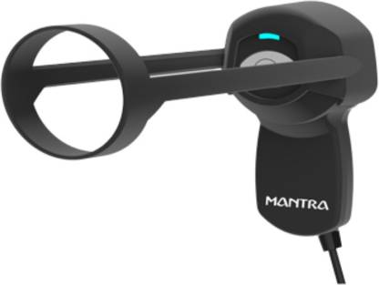
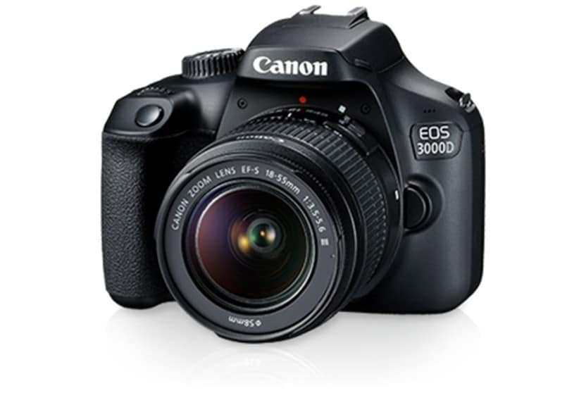
4. PROPOSED SOLUTION
Inclusion Criteria
Those who have given their consent to participate in the study.
Those who have verifiable Diabetic or Non-Diabetic condition.
Exclusion Criteria
Those who have not give their consent to participate in the study or suffer from Conjunctival lesions.
Procedure
An Iris scanner was used to capture the Iris image and a DSLR camera was used for Conjunctival images of the Patients.
Fig. 4 Iris Scanner
Fig. 5 DSLR Camera

Slide 25
5. EXPERIMENTS

Slide 26
5. EXPERIMENTS
General Experimental Setting:
Purpose:
The experiments aim to evaluate the efficacy of machine learning algorithms in detecting diabetes through the analysis of iris and conjunctival images.
The goal is to understand how effectively different models can differentiate between diabetic and non-diabetic individuals based on these images.
The experiments will also investigate the impact of the size of the dataset on model performance by comparing results from datasets of different sizes.
Platform & Tool: The experiments will be conducted on a Windows operating system.
Jupyter Notebook, a widely used tool in the data science and machine learning communities, will be the main tool for these experiments. It allows for:
Efficient manipulation and preprocessing of datasets.
Implementation of various machine learning models.
Evaluation of the performance of these models.
Presentation of results in an understandable and reproducible manner.

Slide 27
5. EXPERIMENTS
Experiment I: Diabetes Detection from Iris Images using Machine Learning
This experiment leverages machine learning for diabetes detection using 276 iris images from an existing dataset and 800 images from a new JNMCH dataset.
Evaluate the performance of machine learning models on the Parsa et al. [11] dataset.
Assess the impact of a larger dataset on model accuracy.
Experiment II: Diabetes Detection from Conjunctival Images using Machine Learning
This experiment extends the iris image analysis to 572 conjunctival images collected from JNMCH.
Evaluate the performance of machine learning models on conjunctival images.
Compare the results with those obtained from iris images.
Experiment III: Combined Iris and Conjunctival Image Analysis for Diabetes Detection using Machine Learning
This experiment utilizes 572 images each from both iris and conjunctival datasets.
Develop models utilizing combined features from both iris and conjunctival images.
Compare the performance of these combined feature models with those trained on individual datasets.

Slide 28
5. EXPERIMENTS
Dataset Description
1. Parsa et al. [11] Iris Dataset
Diabetic Images: 138
Non-Diabetic Images: 138
Total Images: 272
2. JNMCH Iris Dataset
Diabetic Images: 400
Non-Diabetic Images: 400
Total Images: 800
3. JNMCH Conjunctival Dataset
Diabetic Images: 286
Non-Diabetic Images: 286
Total Images: 572

Slide 29
DATA DESCRIPTION
2. JNMCH Iris Dataset
3.1 Diabetic Data (Iris) Mean: 43.81 Median: 44.0 Range: 47 Min Age: 18 Max Age: 65 Variance (Sigma Squared): 140.71 Standard Deviation: 11.86 | 3.2 Non-Diabetic Data (Iris) Mean: 30.92 Median: 26.0 Range: 47 Min Age: 18 Max Age: 65 Variance (Sigma Squared): 122.73 Standard Deviation: 11.07

Slide 30
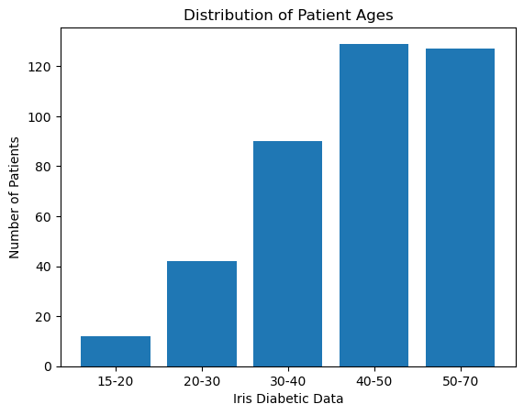
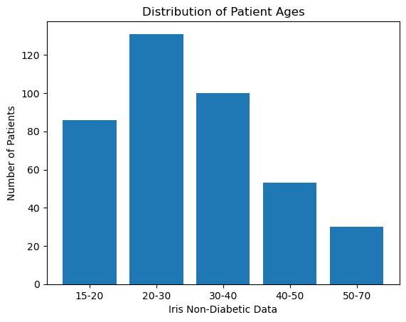
DATA DESCRIPTION
Fig 6: JNMCH Iris Data - Diabetic Patient’s Age Distribution
Fig 7: JNMCH Iris Data – Non-Diabetic Participant’s Age Distribution

Slide 31
DATA DESCRIPTION
3. JNMCH Conjunctival Dataset
3.1 Conjunctival Diabetic Data Mean: 44.8 Median: 45.0 Range: 47 Min Age: 18 Max Age: 65 Variance (Sigma Squared): 132.35 Standard Deviation: 11.50 | 3.2 Conjunctival Non-Diabetic Data Mean: 30.45 Median: 25.0 Range: 37 Min Age: 18 Max Age: 55 Variance (Sigma Squared): 112.84 Standard Deviation: 10.62

Slide 32
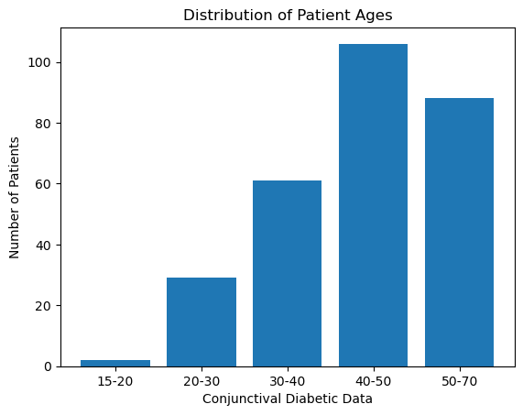
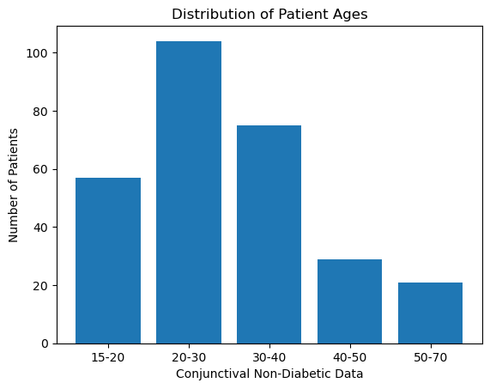
DATA DESCRIPTION
Fig 8: JNMCH Conjunctival Data - Diabetic Patient’s
Age Distribution
Fig 9: JNMCH Conjunctival Data – Non-Diabetic Participant’s
Age Distribution

Slide 33
EXPERIMENT - I
(IRIS DATASET)

Slide 34
EXPERIMENT - I
Experiment I: Diabetes Detection from Iris Images using Machine Learning
This experiment will explore the use of machine learning for the detection of diabetes using iris images. Two datasets will be used: an Parsa et. al [11] dataset of 276 images and a larger, newly collected dataset of 800 images from JNMCH.
Aims:
Evaluate and compare the performance of machine learning models for diabetes detection using the existing iris image dataset.
Investigate the impact of using a larger dataset on the model's performance by applying the same machine learning methods on the newly collected dataset.

Slide 35

EXPERIMENTAL SETUP
Programming Language: Python - leveraged for its robust libraries and compatibility with machine learning and image processing tasks.
Platform: Jupyter Notebook - chosen for its interactive coding environment, ideal for data analysis and modeling.
Operating System: Windows - served as the base system for deploying the Jupyter Notebook and running Python scripts.
Image Processing Library: OpenCV - used for reading, resizing, and preprocessing the input iris images.
Input Data Specifications: Images of dimension 150x150 pixels - chosen to keep the data manageable while maintaining sufficient detail for accurate model training.
Machine Learning Algorithms: Decision Trees, SVM, and KNN - deployed for their individual strengths in classification tasks, and their results compared to identify the optimal algorithm.

Slide 36
Hyperparameter Tuning
Utilized the Grid Search method extensively during our machine learning model development process.
Grid Search is a hyperparameter tuning technique.
It exhaustively tries every combination of hyperparameter values for optimal model performance.
Presented below are the optimized hyperparameters for each model:
1. Decision Tree Classifier:
Optimized max_depth: 100
2. K-Nearest Neighbors Classifier:
Used default settings
3. Support Vector Machine Classifier:
Optimized C: 3.0
Tried different kernels: 'linear', 'poly', 'rbf'
4. Random Forest Classifier:
Optimized n_estimators: 100
5. Naive Bayes Classifier & Gradient Boosting Classifier:
Used default settings, fewer hyperparameters available for tuning.

Slide 37
EXPERIMENT I – Pre Processing
1. Load the Image: We first load the image using the function in grayscale mode.
2. Apply Otsu's Thresholding: This step separates the iris (which we assume to be a darker region) from the rest of the image.
3. Morphological Operations: We perform a series of erosions and dilations on the thresholded image. These operations help to remove any small blobs of noise.
4. Find Contours: We find the contours in the thresholded image. A contour is a curve joining all the continuous points along a boundary that have the same color or intensity.
5. Identify the Iris Contour: We identify the largest contour as the iris.
6. Create a Mask: We create a mask (an array of the same size as the original image), and fill in the contour of the iris.
7. Apply the Mask to the Original Image: We apply the mask to the original image, using a bitwise-and operation. This results in an image with only the iris.
Cropped Image
Fig 10: Preprocessing

Slide 38
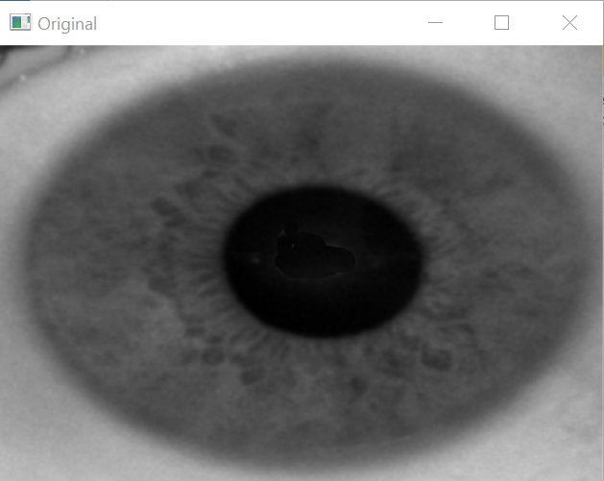
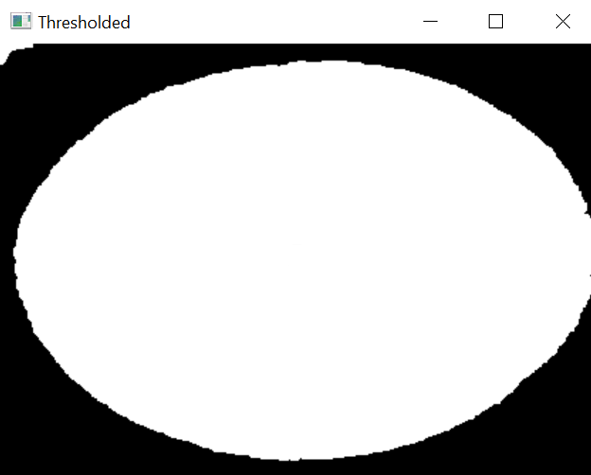
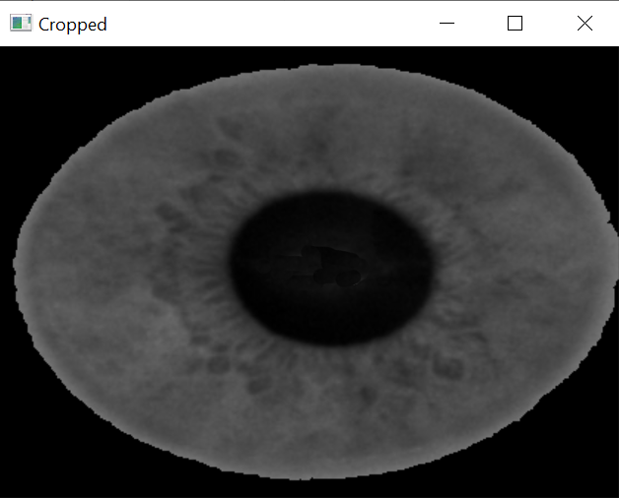
EXPERIMENT I – Pre Processing
Fig 11. Input Image
Fig 12. Otsu Threshold
Fig 13. Cropped Region

Slide 39
EXPERIMENT I – ML Classifier
8. Load the Cropped Image: We first load the cropped image.
10. Encode Labels: Transform categorical labels to numerical values using .
9. Reshape Images: Convert the 3D matrix of each image dataset to a 2D matrix for machine learning model input.
12. Train, Predict, and Evaluate with ML: In each fold, train the ML model, make predictions, and compute accuracy. Also generate classification report and confusion matrix for each fold.
13. Calculate Average Accuracy: After all folds, compute and print the average accuracy as the final model performance metric.
11. Setup k-Fold Cross-Validation: Implement a 10-fold cross-validation for model evaluation.
Fig 14: ML Classifier

Slide 40
EXPERIMENT I - RESULTS
Model | Accuracy
SVM (Poly) | 95%
SVM (rbf) | 92.5%
SVM (linear) | 91%
Decision Tree | 83.9%
KNN | 84%
Random Forest | 94.16%
Gradient Boosting | 91%
Naïve Baiyes | 81%
Model | Accuracy
SVM (Poly) | 93%
SVM (rbf) | 91%
SVM (linear) | 90%
Decision Tree | 83%
KNN | 89%
Random Forest | 94%
Gradient Boosting | 91%
Naïve Baiyes | 78%
Table 1: JNMCH Iris Dataset
Table 2: Parsa et al. [11] Iris Dataset

Slide 41
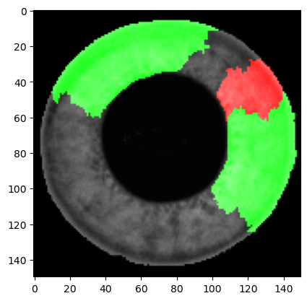
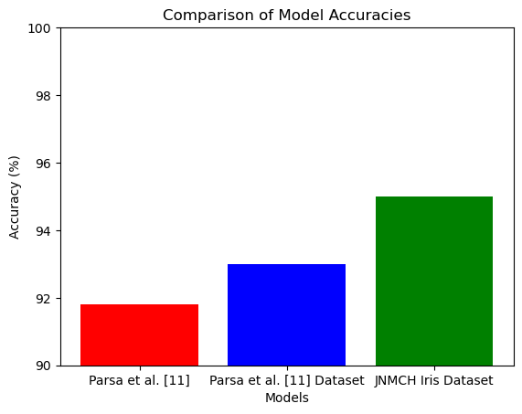
EXPERIMENT I - DISCUSSION
Fig 15: Region of Interest SVM (poly)
Fig 16: Experiment 1 Comparison Bar graph

Slide 42
EXPERIMENT- II
(CONJUNCTIVAL DATASET)

Slide 43
EXPERIMENT II
Experiment II: Diabetes Detection from Conjunctival Images using Machine Learning
Building upon Experiment I, this experiment will expand the analysis to conjunctival images.
A dataset of 572 conjunctival images (both diabetic and non-diabetic) collected from JNMCH will be used.
Aims:
Apply the machine learning techniques to conjunctival images for diabetes detection.
Evaluate the performance of the models on the conjunctival image dataset.

Slide 44
EXPERIMENTAL SETUP
Programming Language: Python - leveraged for its robust libraries and compatibility with machine learning and image processing tasks.
Platform: Jupyter Notebook - chosen for its interactive coding environment, ideal for data analysis and modeling.
Operating System: Windows - served as the base system for deploying the Jupyter Notebook and running Python scripts.
Image Processing Library: OpenCV - used for reading, resizing, and preprocessing the input conjunctival images.
Input Data Specifications: Images of dimension 150x150 pixels - chosen to keep the data manageable while maintaining sufficient detail for accurate model training.
Machine Learning Algorithms: Decision Trees, SVM, and KNN - deployed for their individual strengths in classification tasks, and their results compared to identify the optimal algorithm.

Slide 45
Hyperparameter Tuning
Utilized the Grid Search method extensively during our machine learning model development process.
Grid Search is a hyperparameter tuning technique.
It exhaustively tries every combination of hyperparameter values for optimal model performance.
Presented below are the optimized hyperparameters for each model:
1. Decision Tree Classifier:
Optimized max_depth: 100
2. K-Nearest Neighbors Classifier:
Used default settings
3. Support Vector Machine Classifier:
Optimized C: 10.0
Tried different kernels: 'linear', 'poly', 'rbf'
4. Random Forest Classifier:
Optimized n_estimators: 100
5. Naive Bayes Classifier & Gradient Boosting Classifier:
Used default settings, fewer hyperparameters available for tuning.

Slide 46
EXPERIMENT II – Pre Processing
1. Load the Image: We first load the image using the function in grayscale mode.
2. Apply Otsu's Thresholding: This step separates the iris (which we assume to be a darker region) from the rest of the image.
3. Morphological Operations: We perform a series of erosions and dilations on the thresholded image. These operations help to remove any small blobs of noise.
4. Find Contours: We find the contours in the thresholded image. A contour is a curve joining all the continuous points along a boundary that have the same color or intensity.
5. Identify the Iris Contour: We identify the largest contour as the iris.
6. Create a Mask: We create a mask (an array of the same size as the original image), and fill in the contour of the iris.
7. Apply the Mask to the Original Image: We apply the mask to the original image, using a bitwise-and operation. This results in an image with only the iris.
Cropped Image
Fig 17: Preprocessing

Slide 47
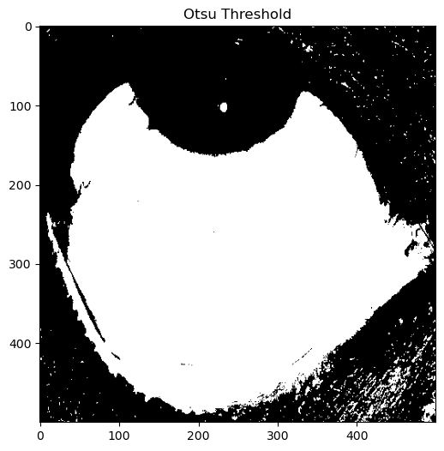

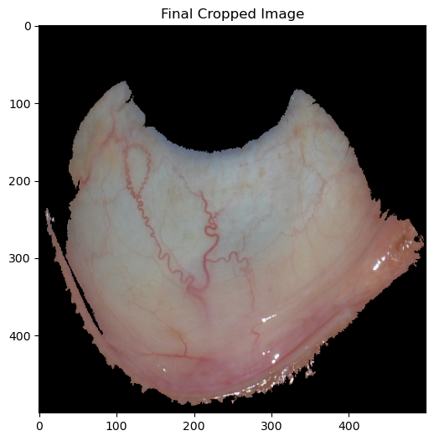
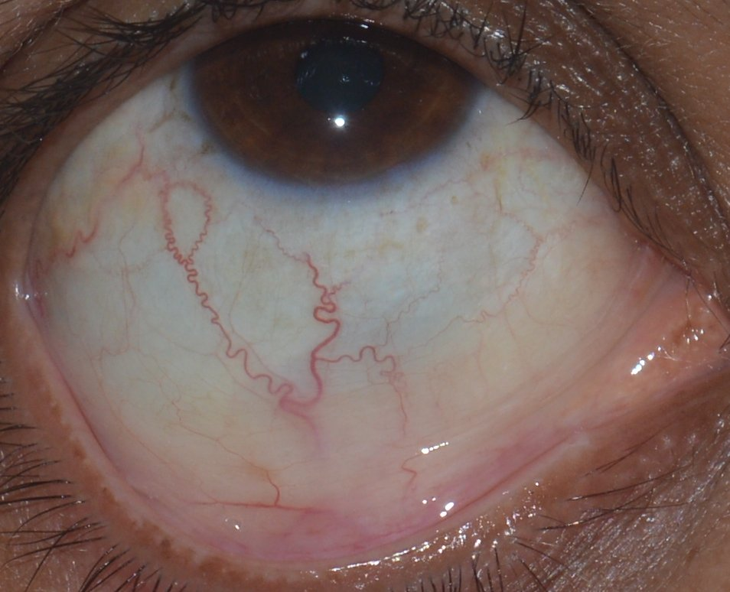
EXPERIMENT II – Pre Processing
Fig. 18 Input Image
Fig 19. Otsu Threshold
Fig. 20
Mask with largest Contour
Fig. 21 Cropped Region

Slide 48
EXPERIMENT II – ML Classifier
8. Load the Cropped Image: We first load the cropped image.
10. Encode Labels: Transform categorical labels to numerical values using .
9. Reshape Images: Convert the 3D matrix of each image dataset to a 2D matrix for machine learning model input.
12. Train, Predict, and Evaluate with ML: In each fold, train the ML model, make predictions, and compute accuracy. Also generate classification report and confusion matrix for each fold.
13. Calculate Average Accuracy: After all folds, compute and print the average accuracy as the final model performance metric.
11. Setup k-Fold Cross-Validation: Implement a 10-fold cross-validation for model evaluation.
Fig 22: ML Classifier

Slide 49
EXPERIMENT II - RESULTS
Model | Accuracy
SVM (Poly) | 93.3%
SVM (rbf) | 93 %
SVM (linear) | 90%
Decision Tree | 84%
KNN | 85%
Random Forest | 93 %
Gradient Boosting | 93%
Naïve Baiyes | 79%
Table 3: JNMCH Conjunctival Dataset Model Results

Slide 50
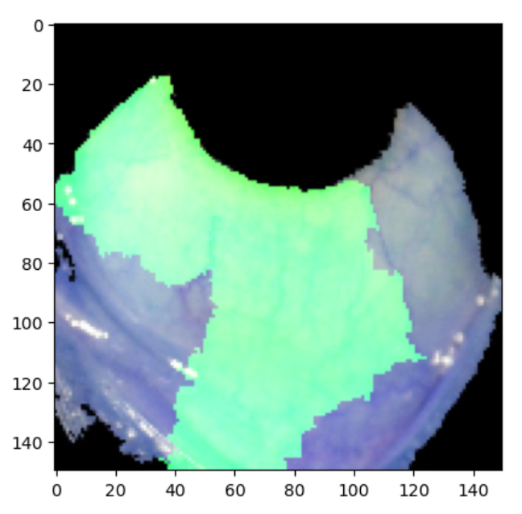

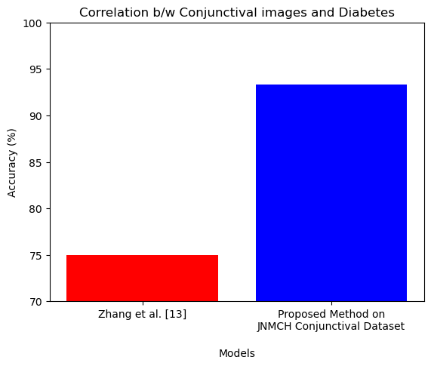
EXPERIMENT II - DISCUSSION
Fig 23: Region of Interest SVM (poly)
Fig 24: Experiment II Comparison Bar graph

Slide 51
EXPERIMENT III
(IRIS+CONJ DATASET)

Slide 52
EXPERIMENT III
Experiment III: Combined Iris and Conjunctival Image Analysis for Diabetes Detection using Machine Learning
This experiment aims to integrate the features from both iris and conjunctival images to improve the detection of diabetes. Equal-sized datasets of 572 images each from both iris and conjunctival datasets will be used.
Aims:
Develop method that can effectively use combined features from both types of images to enhance the accuracy of diabetes detection.
Compare the performance of these models with those trained on individual datasets to determine the benefits of the integrated approach.

Slide 53
EXPERIMENTAL SETUP
Programming Language: Python - leveraged for its robust libraries and compatibility with machine learning and image processing tasks.
Platform: Jupyter Notebook - chosen for its interactive coding environment, ideal for data analysis and modeling.
Operating System: Windows - served as the base system for deploying the Jupyter Notebook and running Python scripts.
Image Processing Library: OpenCV - used for reading, resizing, and preprocessing the input conjunctival images.
Input Data Specifications: Images of dimension 150x150 pixels - chosen to keep the data manageable while maintaining sufficient detail for accurate model training.
Machine Learning Algorithms: Decision Trees, SVM, and KNN - deployed for their individual strengths in classification tasks, and their results compared to identify the optimal algorithm.

Slide 54
Hyperparameter Tuning
Utilized the Grid Search method extensively during our machine learning model development process.
Grid Search is a hyperparameter tuning technique.
It exhaustively tries every combination of hyperparameter values for optimal model performance.
Presented below are the optimized hyperparameters for each model:
1. Decision Tree Classifier:
Optimized max_depth: 100
2. K-Nearest Neighbors Classifier:
Used default settings
3. Support Vector Machine Classifier:
Optimized C: 3.0
Tried different kernels: 'linear', 'poly', 'rbf'
4. Random Forest Classifier:
Optimized n_estimators: 100
5. Naive Bayes Classifier & Gradient Boosting Classifier:
Used default settings, fewer hyperparameters available for tuning.

Slide 55
EXPERIMENT III – Pre Processing
1. Load the Image: We first load the image using the function in grayscale mode.
2. Apply Otsu's Thresholding: This step separates the iris (which we assume to be a darker region) from the rest of the image.
3. Morphological Operations: We perform a series of erosions and dilations on the thresholded image. These operations help to remove any small blobs of noise.
4. Find Contours: We find the contours in the thresholded image. A contour is a curve joining all the continuous points along a boundary that have the same color or intensity.
5. Identify the Iris Contour: We identify the largest contour as the relevant region.
6. Create a Mask: We create a mask (an array of the same size as the original image), and fill in the contour of the iris.
7. Apply the Mask to the Original Image: We apply the mask to the original image, using a bitwise-and operation. This results in an image with only the relevant region
Cropped Image
Fig 25: Preprocessing

Slide 56
EXPERIMENT III – ML Classifier
1. Load the Cropped Image: We first load the cropped image.
3. Encode Labels: Transform categorical labels to numerical values using .
4. Combine the Features: Concatenate the features of both image datasets into a single dataset.
2. Reshape Images: Convert the 3D matrix of each image dataset to a 2D matrix for machine learning model input.
6. Train, Predict, and Evaluate with ML: In each fold, train the ML model, make predictions, and compute accuracy. Also generate classification report and confusion matrix for each fold.
7. Calculate Average Accuracy: After all folds, compute and print the average accuracy as the final model performance metric.
5. Setup k-Fold Cross-Validation: Implement a 10-fold cross-validation for model evaluation.
Fig 26: ML Classifier

Slide 57
EXPERIMENT III - RESULTS
ML Model | Accuracy
SVM (Poly) | 96.78%
SVM (rbf) | 92%
SVM (linear) | 90%
Decision Tree | 80%
KNN | 91%
Random Forest | 88%
Gradient Boosting | 93%
Naïve Baiyes | 86%
DL Model | Accuracy
ResNet101 | 88%
ResNet50 | 90%
DenseNet121 | 86%
MobileNet | 90%
XceptionNet | 87%
VGG16 | 89%
VGG19 | 84%
Table 4: ML Model Results
Table 5: DL Model Results

Slide 58
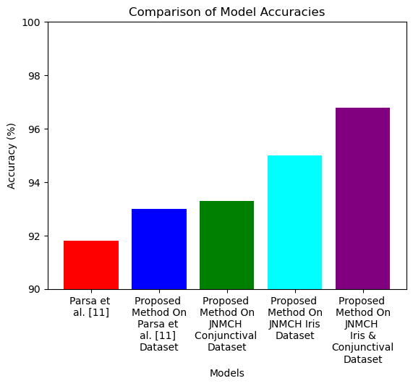
EXPERIMENT III - DISCUSSION
Fig. 27: Experiment III Comparison Bar graph

Slide 59
6. CONCLUSION

Slide 60
CONCLUSION
Key Takeaways from Experiment I: Detecting Diabetes from Iris Images using Machine Learning
Outstanding Model Accuracy on JNMCH Iris Dataset:
SVM (Poly) model excelled with 95% accuracy.
High Performance across Multiple Models: SVM (RBF), SVM (Linear), Gradient Boosting, and Random Forest all achieved over 90% accuracy.
Benchmarking on Previous Data:
Utilized the Parsa et. al [11] 276-image dataset for benchmarking.
Attained a top accuracy of 93%, outdoing the previous record of 91.8% mentioned in Parsa et al.'s study.
Affirmation of Improved Model Performance:
Highlighted machine learning's crucial contribution to early, precise diabetes detection via iris images.
The successful experiments and comprehensive data gathering signify substantial progress in non-invasive diabetes detection.

Slide 61
CONCLUSION
Key Insights from Experiment II: Detecting Diabetes from Conjunctival Images using Machine Learning
SVM (Poly) model excelled with 93% accuracy.
The Value of Conjunctival Images:
Demonstrated the effectiveness of conjunctival images for non-invasive diabetes detection.
High accuracy outcomes validate the potential of conjunctival images to improve detection methods.
Consistent Model Performance:
Verified SVM (Poly) model's robustness and versatility across both iris and conjunctival images.
Consistent high accuracies support the use of machine learning in diabetes detection.
Filling the Research Void:
One of the few studies using conjunctival images, providing new insights and filling a significant research gap.
Encourages further exploration and usage of conjunctival images in the medical field.
The significant results expand the scope for non-invasive diabetes detection.

Slide 62
CONCLUSION
Key Insights from Experiment III: Detecting Diabetes by Combining Iris and Conjunctival Features
Excellence of Feature Fusion:
The combined iris and conjunctival feature dataset scored an outstanding accuracy of 96.78% using the SVM (Poly) model, thus establishing the efficiency of a blended approach in diabetic detection.
2. Strong Performance Across Different Models:
Apart from SVM (Poly), multiple models like SVM (Linear), SVM (RBF), KNN, and Gradient Boosting also showcased strong results with accuracy scores over 90%.
This indicates the robustness and versatility of the combined feature set.
3. Effective Utilization of Pre-Trained Models:
The employment of pre-trained models like ResNet50, ResNet101, DenseNet, MobileNet, XceptionNet, and VGG16 provided a combined average accuracy of 88%.
This underlines the potential of transfer learning methods in enhancing the detection of diabetes.

Slide 63
CONCLUSION
Final Conclusion
Harnessing Non-invasive Techniques: The study innovatively used non-invasive iris and conjunctival imaging, marking a pioneering step towards early diabetes detection, thereby confronting the global issue of latent diagnoses.
Leveraging Existing Infrastructure: By using existing medical imaging equipment, the study negated the need for additional hardware or invasive procedures, reshaping the landscape of diabetes detection techniques.
Machine Learning: A Reliable Ally: The research endorsed machine learning techniques as not just accurate, but also interpretative and efficient, thereby presenting a promising alternative to the often resource-intensive deep learning methods.
Overcoming Data Scarcity: The research amassed a diverse collection of 800 iris and 572 conjunctival images to overcome the data availability challenges, a contribution that offers significant potential for future research, especially within the Indian demographic context.

Slide 64
CONCLUSION
Experimental Success: A series of experiments highlighted the potent efficacy of machine learning models, with remarkable accuracy rates of 95%, 93%, and 96.78% for iris, conjunctival, and combined features respectively.
Correlation & Model Efficacy: The research demonstrated a strong correlation between iris and conjunctival image features and diabetes detection. Significant number of models exceeding the 90% accuracy threshold, the study underscored the credibility of machine learning in early diabetes detection.
Revolutionizing Early Detection: The convergence of machine learning and non-invasive imaging in this study sets a precedent for highly efficient, accurate early detection systems, thus changing the outlook for future diabetes screening tools.
Implications for Future Research: Ultimately, this study serves as a robust foundation for future exploration in this field, paving the way for advancements that could transform prognosis and patient experiences globally.

Slide 65
FUTURE WORK
Advanced Models Exploration: Utilize more sophisticated machine learning and deep learning models to potentially enhance results.
Multi-Disease Framework: Expand the developed framework to detect multiple diseases, including other ocular and systemic conditions.
Clinical Integration: Investigate practical implications and benefits of embedding these models in clinical practice for early detection of diabetes.
Expansive Diverse Datasets: Collect larger and more diverse datasets, capturing data from various regions, ages, and disease stages to boost model's universality.
Real-time Detection Systems: Develop real-time disease detection systems using portable devices, moving towards point-of-care diagnostics.
These future avenues will further bolster the substantial groundwork laid by this research, potentially transforming the domain of non-invasive diabetes detection.

Slide 66

REFERENCES
https://idf.org/about-diabetes/facts-figures/ (Retrieved on: 20 Dec 2022)
https://economictimes.indiatimes.com/magazines/panache/india-has-over-100-mn-diabetics-136-mn-pre-diabetics-says-new-icmr-study-goa-tops-the-list-up-records-lowest-prevalence/articleshow/100866686.cms?from=mdr (Retrieved on: 20 Dec 2022)
https://www.niddk.nih.gov/health-information/diagnostic-tests/a1c-test (Retrieved on: 20 Dec 2022)
https://www.cdc.gov/diabetes/basics/getting-tested.html#:~:text=Fasting%20Blood%20Sugar%20Test,higher%20indicates%20you%20have%20diabetes. (Retrieved on: 20 Dec 2022)
https://www.ncbi.nlm.nih.gov/books/NBK532915/#:~:text=The%20results%20of%20the%20OGTT,200%20mg%2FdL%20indicates%20diabetes (Retrieved on: 20 Dec 2022)
https://www.cdc.gov/diabetes/basics/getting-tested.html#:~:text=Random%20Blood%20Sugar%20Test,higher%20indicates%20you%20have%20diabetes.&text=*Results%20for%20gestational%20diabetes%20can%20differ. (Retrieved on: 25 July 2023)
https://medlineplus.gov/lab-tests/glucose-in-urine-test/ (Retrieved on: 25 July 2023)

Slide 67
REFERENCES
S. Lekha and S. M, "Recent Advancements and Future Prospects on E-Nose Sensors Technology and Machine Learning Approaches for Non-Invasive Diabetes Diagnosis: A Review," in IEEE Reviews in Biomedical Engineering, vol. 14, pp. 127-138, 2021, doi: 10.1109/RBME.2020.2993591.
Önal, M.N., Güraksin, G.E. & Duman, R. Convolutional neural network-based diabetes diagnostic system via iridology technique. Multimed Tools Appl 82, 173–194 (2023). https://doi.org/10.1007/s11042-022-13291-3
R. Aminah and A. H. Saputro, "Diabetes Prediction System Based on Iridology Using Machine Learning," 2019 6th International Conference on Information Technology, Computer and Electrical Engineering (ICITACEE), Semarang, Indonesia, 2019, pp. 1-6, doi: 10.1109/ICITACEE.2019.8904125.
P. Moradi, N. Nazer, A. K. Ahmadi, H. Mohammadzade and H. K. Jafari, "Discovering Informative Regions in Iris Images to Predict Diabetes," 2018 25th National and 3rd International Iranian Conference on Biomedical Engineering (ICBME), Qom, Iran, 2018, pp. 1-6, doi: 10.1109/ICBME.2018.8703564.
I. P. D. Lesmana, I. K. E. Purnama and M. H. Purnomo, "Abnormal condition detection of pancreatic Beta-cells as the cause of Diabetes Mellitus based on iris image," 2011 2nd International Conference on Instrumentation, Communications, Information Technology, and Biomedical Engineering, Bandung, Indonesia, 2011, pp. 150-155, doi: 10.1109/ICICI-BME.2011.6108614.

Slide 68
REFERENCES
Li, X., Xia, C., Li, X. et al. Identifying diabetes from conjunctival images using a novel hierarchical multi-task network. Sci Rep 12, 264 (2022). https://doi.org/10.1038/s41598-021-04006-z
Khansari, Maziyar M., et al. "Automated fine structure image analysis method for discrimination of diabetic retinopathy stage using conjunctival microvasculature images." Biomedical optics express 7.7 (2016): 2597-2606.
To, Wilson J., et al. "Correlation of conjunctival microangiopathy with retinopathy in type-2 diabetes mellitus (T2DM) patients." Clinical hemorheology and microcirculation 47.2 (2011): 131-141.

Slide 69
Thank You

